Slide 1
RSA (An asymmetric key cryptography algorithm)

Slide 2
RSA
An asymmetric key cryptography algorithm
Developed by Rivest-Shamir-Adleman
We can use this to share a secret between two parties.

Slide 3
Why?
We can share a secret with two parties using this technique
We already looked at Diffie-Hellman algorithm
There is a special property of this strategy that allows you to guarantee the authenticity of the sender as well.

Slide 4
Asymmetric key cryptography vs symmetric key cryptography
Symmetric key cryptography
Each party has possession of a key K
Key K is used for both encryption and decryption
Often fast encryption and decryption speeds
Asymmetric key cryptography
Uses two keys
Public key and Private key
Public key is shared, and private key is kept as a secret.

Slide 5
Asymmetric key cryptography
Asymmetric key cryptography
Uses two keys
Public key and private key
Public key is shared, and private key is kept as a secret.
Public key is used to encrypt, and private key is used to decrypt.
Once you encrypt a message using public key, it cannot be decrypted again using the same public key.
Provides two functionalities
Encryption and Decryption
Signing and Verification

Slide 6
RSA example
Suppose Alice wants to send a message to Bob
Bob publishes his public key (e, n) (Ex: (5, 14))
Bob keeps his private key private (d, n). (Ex: (11, 14))
Note that public key and private key are a pairs of numbers.
Let’s try an example on how to encrypt and decrypt
Also let’s try to see what signing and verification mean.

Slide 7
How to create public and private key
Note that you cannot just use random values as your private key public key pairs.
There is an algorithm to choose these values.

Slide 8
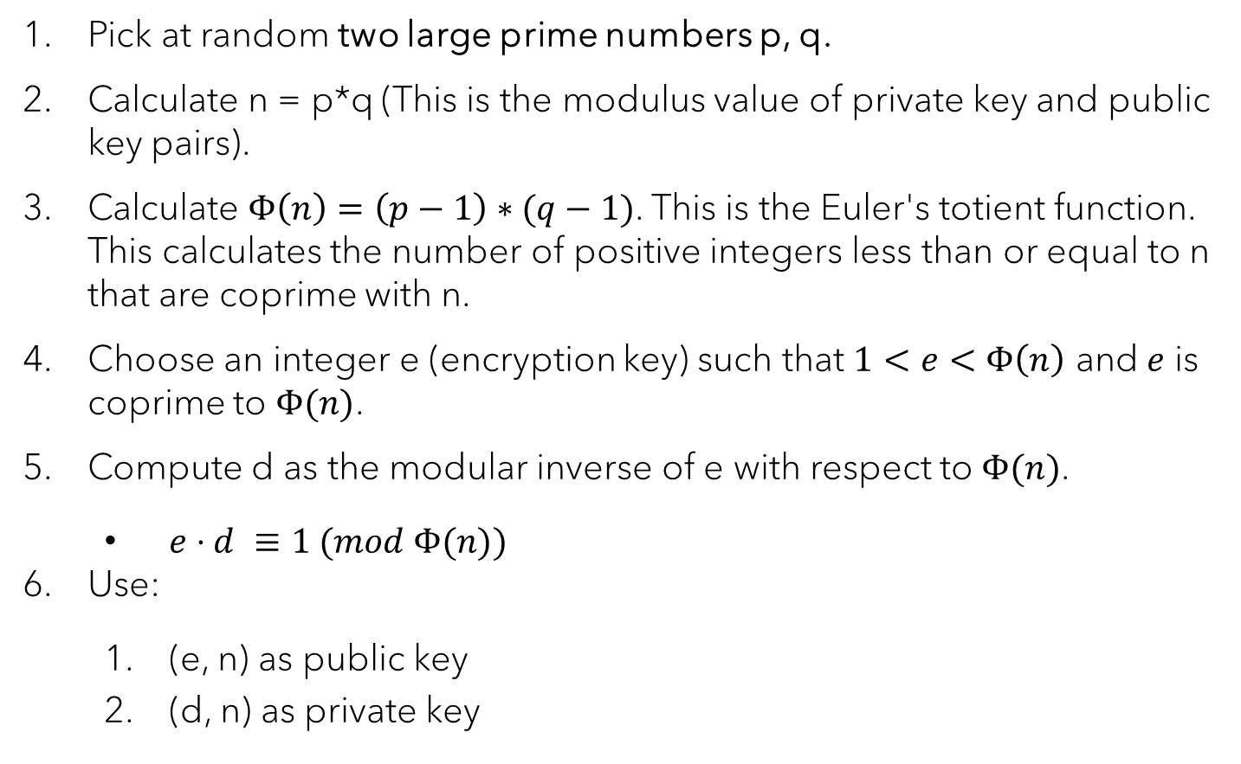
RSA algorithm
Pick at random two large prime numbers p, q.
Calculate n = p*q (This is the modulus value of private key and public key pairs).
Calculate $Φ\left(n\right)=\left(p−1\right)∗(q−1)$. This is the Euler's totient function. This calculates the number of positive integers less than or equal to n that are coprime with n.
Choose an integer e (encryption key) such that $1<e<Φ\left(n\right)$ and $e$ is coprime to $Φ(n)$.
Compute d as the modular inverse of e with respect to $Φ(n)$.
$e⋅d ≡1 (mod Φ(n))$
Use:
(e, n) as public key
(d, n) as private key

Slide 9
RSA algorithm
What is the problem with this?
Could this strategy guarantee the authenticity of the sender?

Slide 10










Bob’s public key
Alice’s public key
Bob’s private Key
Alice’s private Key
Alice
Bob
Mallory

Slide 11
RSA algorithm
What is the problem with this?
Could this strategy guarantee the authenticity of the sender?
No
Can we add something ensure authenticity?
How about digitally signing the public key?
What does this mean?

Slide 12
Certificate authorities
We need an extra step to ensure the authenticity of public keys.
Certificate authorities are entities in the business of signing certificates.
Certificate authorities sign the public keys of others.
As long as we have the public key of the certificate authority, we can verify the authenticity of the signed public key.

Slide 13
Certificate authorities
There are a few assumption (We = verifier)
We assume that certificate authorities verified the owner of the public key that they signed.
We assume that we have the correct public key of the certificate authority.
We assume that the private key of the certificate authority is not compromised.
Trusted stores (public keys of certificate authorities are stored)
OS has a trusted store that contains a set of public keys from certificate authorities.
Some browsers also keep a trusted store.

Slide 14
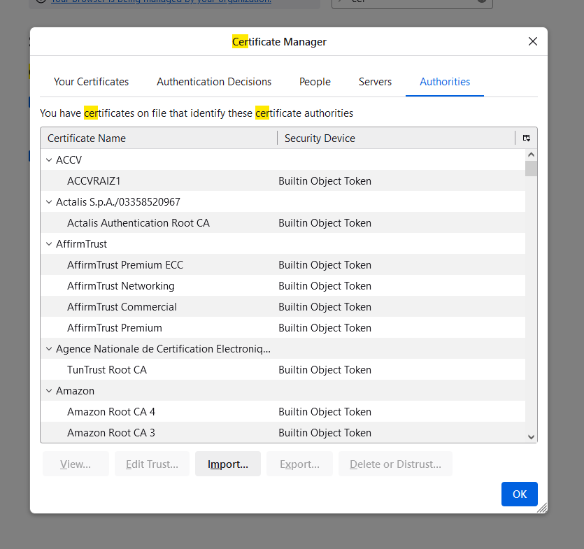

Slide 15
